Slide 1

Week Three
Lit Terms

Slide 2
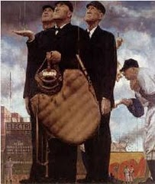
Inference
A conclusion drawn from evidence
To infer - You make a guess about what will happen next.
  Example: The baseball team watched the rain fall on the field and then began to pack up their equipment.

Slide 3
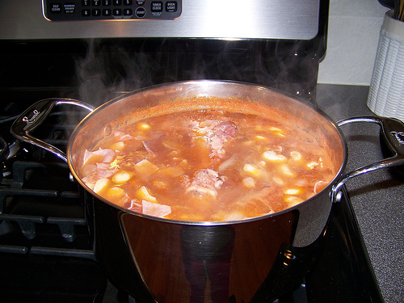
Imagery
The use of words or whole sentences to describe sights, smells, sounds, tastes, and other things that can be sensed.
If you can “picture” it, or smell it, or taste it as you read, it is imagery.
  Example: The soup looked like a pot of boiling blood and smelled like dirty gym socks.

Slide 4
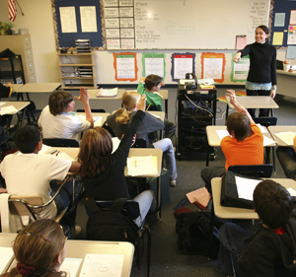
Loaded Language
Wording that attempts to influence the reader by appealing to emotion.
Often used in a biased or unfair way.
Example: The students listened to the teacher’s brilliant and inspiring lecture with rude boredom.

Slide 5
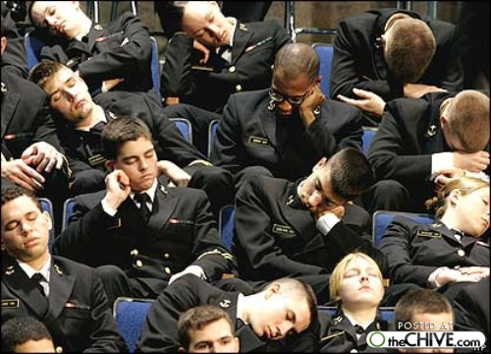
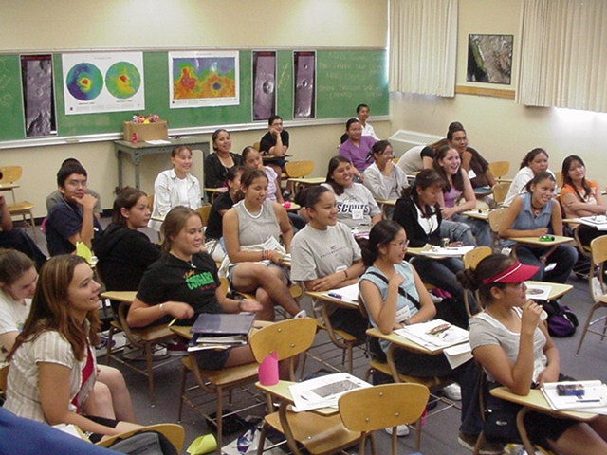

Slide 6
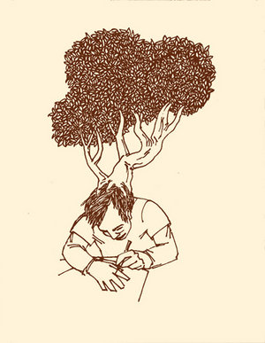
Metaphor
A comparison between two unlike things
DOES NOT USE the word LIKE
Metaphor
- America IS a melting pot.
- Ideas are plants. Once they are planted, they continue to grow. →
Simile (uses like or as)
She laughs like a parrot.
His head is as big as a bus.

Slide 7
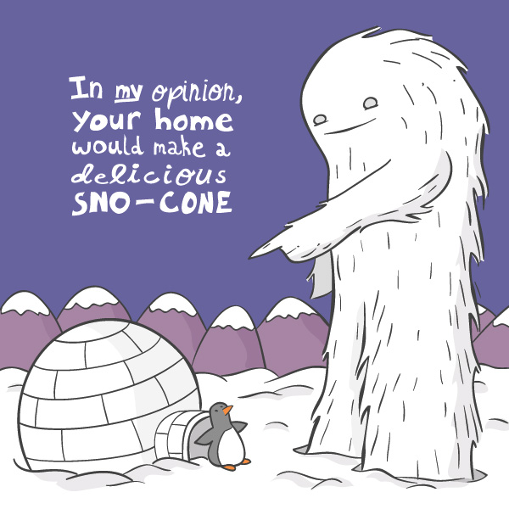
Opinion
A statement about what someone thinks, but can’t be proved or disproved.
Often begins with “I think, I believe, etc.”
Examples:
I think Speak is the best book I’ve ever read.
I believe that Santa is real, no matter what you say.
Road of the Dead is way too violent.

Slide 8
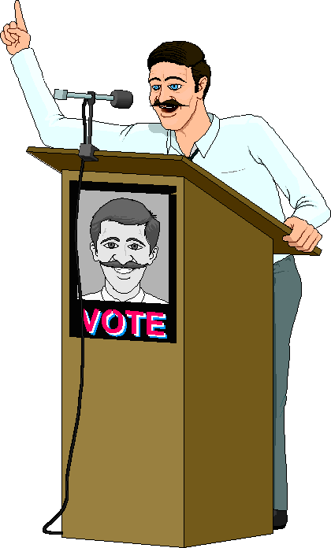
Persuasion
Writing that tries to persuade you to accept the author’s opinion.
Examples:
“The House of Scorpion is the best book in the unit because it won so many awards.”
Blue is the best color because it’s the color of the ocean.

Slide 9

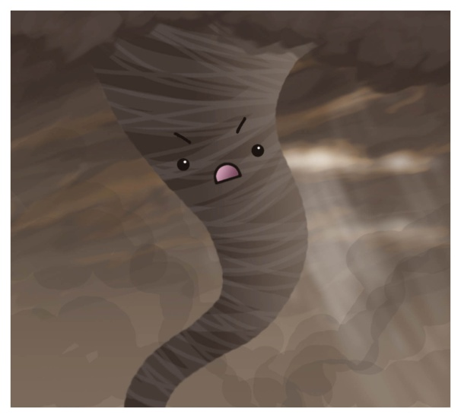
Personification
When a non-human thing is given the characteristics of a human.
Person-ification – Making into a person.
Examples:
The stars danced playfully in the moonlit sky.
The thunder grumbled like an old man.
The tornado ran through town without a care.

